Slide 1

Pimpri Chinchwad Education Trust (PCET) Pimpri Chinchwad College of Engineering An ISO 9001:2015 Certified Institute, NBA Accredited, Accredited by NAAC with ‘A’ grade
Predictive Maintenance & Diagnostic Report Generation using LLM
Project Guide: Mrs. Babita R. Jane
Project ID: B3
121B1F069: Chetan Mahale
121B1F072: Sanchalee Meshram
121B1F080: Pranav Narkhede

Slide 2

Introduction

Slide 3
Introduction
Definition: Leveraging data science and machine learning to anticipate equipment failures before they occur, optimizing maintenance schedules and boosting operational efficiency.
Role of LLMs: Automate diagnostic report generation, analyze vast data, and provide actionable insights to drive informed decisions.
Significance: Reducing unexpected breakdowns, minimizing maintenance costs, and enhancing reporting accuracy and speed. Optimizing resource allocation and elevating equipment reliability across industries.

Slide 4

Literature Survey

Slide 5
SrNo | Title and Link | Methodology | Results
1. | Review On Predictive Maintenance in Industry 4.0: Overview, Models, and Challenges[1] | Reviewed literature on smart industrial maintenance. Covered predictive maintenance - evaluation, tools and materials, challenges, workflow, various PdM models like CBM, and models for RUL prediction. | Possible to notice intelligent maintenance is a new tool to handle maintenance events. Proposed a novel multifunctional platform of industrial predictive maintenance based on asset management and smart maintenance planning.
2. | Machine Learning approach for Predictive Maintenance in Industry 4.0 | Collected datasets from sensors for the cutting machine. Random Forest for multi-label classification. | Overall Accuracy: 0.95 Average Accuracy: 0.92 Precision: 0.94 Recall: 0.95

Slide 6
SrNo | Title and Link | Methodology | Results
3. | Machine Learning for Predictive Maintenance: a Multiple Classifier Approach | Proposed two multi-class PdM training algorithms that use Monte Carlo simulations and can be adapted to any classification algorithm. In this article, SVM and KNN are used. | SVM: No of simulations = 10 Accuracy: 98.47 Precision: 63.14 Recall: 70.84 No of simulations = 20 Accuracy: 98.37 Precision: 56.61 Recall: 77.77 KNN: No of simulations = 10 Accuracy: 98.47 Precision: 64.09 Recall: 67.85 No of simulations = 20 Accuracy: 98.39 Precision: 58.00 Recall: 75.42

Slide 7
SrNo | Title and Link | Methodology | Results
4. | DefectTwin: When LLM Meets Digital Twin for Railway Defect Inspection | Addressed the challenge of limited samples by integrating pre-trained LLM into Digital Twin. Utilizes multimodal and multi-model (M²) LLM-based AI pipeline to analyze seen and unseen visual defects in railways. | Image: Precision: 0.92 Recall: 0.93 F1- Score: 0.92 AUC: 0.93 Video: Precision: 0.76 Recall: 0.74 F1- Score: 0.77 AUC: 0.77
5. | A real-time predictive maintenance system for machine systems | Introduced effective real-time predictive maintenance based on motion current which can detect abnormal electric conditions. MLP with softmax activation function was used and was trained using scaled conjugate gradient (SCG) optimization. | Precision: 97.59%. Classification is not affected by parameters and hence it is observed that the motion current signature is independent of tuning parameters

Slide 8
SrNo | Title and Link | Methodology | Results
6. | Self-supervised LLM customizer (SSLC): Customizing LLMs on unlabeled data to enhance contextual question answering | Proposed a framework (SSLC) for customizing LLMs using unlabeled text to enhance contextual question answering on custom data. Text Segmentation → Sentence Extraction → Synthesis → Curation → Fine Tuning | Excels baseline models in 75% of the experiments by both qualitative and quantitative metrics. Dataset: AdversarialQA Model: Mistral (7B) ROUGE-2: 0.21 ROUGE-L: 0.41 METEOR: 0.36 BERT-F1: 0.91 Human Eval(proxy): 0.46
7. | Log-based Predictive Maintenance | Used Multi-Instance Learning[MIL] which includes creating bags of instances. The combined approach of instance-to-example, meta-examples, and instance-based supervised learning is used. | Features: 389 Precision: 0.9 Recall: 0.86 Features: 297 Precision: 0.84 Recall: 0.73

Slide 9
SrNo | Title and Link | Methodology | Results
8. | Advanced Machine Learning Techniques for Predictive Maintenance in Industrial IoT: Integrating Generative AI and Deep Learning for Real-Time Monitoring (Hypothesis) | Uses Gen-AI for PdM on Industrial IoT sensors Big Data. Data Augmentation Hybrid CNN-RNN model development Real Time anomaly detection and failure prediction | Metrics will be: Precision, Recall, F1-Score The effectiveness of the model will be assessed by comparing its performance with a baseline model trained solely on real-world sensor data collected from the testbed.
9. | A Text-Based Predictive Maintenance Approach for Facility Management Requests Utilizing Association Rule Mining and Large Language Models | Used temporal association mining, predictive maintenance, temporal filter, semantic similarity on textual data. The goal is to identify and predict maintenance needs based on historical facility management requests. It compares 4 LLM models. | The English RoBERTa model has highest acceptance rates for the minimum similarity thresholds of 0.65 and 0.7.
10. | Scalable Development and Deployment of LLMs in Manufacturing: Leveraging AI to Enhance Predictive Maintenance, Quality Control, and Process Automation | Transfer learning, Federated learning, model compression, edge computing, cloud and edge deployment. | The study demonstrates that using LLMs in manufacturing leads to more accurate predictions for maintenance, reducing machine downtime and repair costs. It also enhances quality control by automating inspections, resulting in fewer defects.

Slide 10
SrNo | Title and Link | Methodology | Results
11. | Towards Automated Solution Recipe Generation for Industrial Asset Management with LLM | Data collection, LLM integration, solution recipe generation, automation framework, evaluation. | The results of the paper show that using LLMs to automatically generate maintenance solutions significantly improves the efficiency of asset management. The model successfully provides clear, step-by-step instructions that reduce equipment downtime and optimize performance.
12. | Robot fault detection and remaining life estimation for predictive maintenance | Survival analysis, extremely randomized trees, K-nearest neighbors, convolutional neural networks. | Without PCA, extremely randomized trees: Survival analysis = 0.76 Accuracy = 0.95 Precision = 0.98 Recall = 0.96 With PCA, extremely randomized trees: Survival analysis = 0.80 Accuracy = 0.98 Precision = 0.98 Recall = 0.96

Slide 11
SrNo | Title and Link | Methodology | Results
13. | Predictive maintenance for aircraft components using proportional hazard models | Data collection, proportional hazard models, extreme value analysis, reliability modeling. | Proportional hazard models significantly improved predictive maintenance for aircraft components. Model reduced unscheduled failures by up to 90% without increasing costs.
14. | Predictive Maintenance Optimization for Aircraft Redundant Systems Subjected to Multiple Wear Profiles | Data collection, wear profile analysis, predictive modeling, optimization, simulation. | The optimal predictive maintenance strategy reduced overall maintenance costs of aircraft components. In one case, the cost was reduced from 1.7 to 0.56 compared to a reactive approach.
15. | A research study on unsupervised machine learning algorithms for early fault detection in predictive maintenance | Exhaust fan vibration data was collected every 240 minutes over 12 days. Features like peak acceleration and velocity were extracted, PCA to reduce dataset, algorithms such as hierarchical clustering, model based clustering. | Results show that unsupervised machine learning algorithms, particularly clustering and PCA were effective in early fault detection.

Slide 12
SrNo | Title and Link | Methodology | Results
16. | A Digital Twin predictive maintenance framework of air handling units based on automatic fault detection and diagnostics | Data collection, digital twin creation, fault detection, condition precondition, maintenance planning and framework validation. | When the cooling valve is closed during the cooling phase: Accuracy = 87.5% error = 12.5%. When dampers are closed: Accuracy = 80%, error = 20%. No faults: Accuracy = 99.8%, error = 0.2%
17. | Predictive Maintenance using Machine Learning | Continuously monitoring and collecting sensor data from the tubing machine, followed by cleaning and preparing the gathered information to extract relevant features and identify potential patterns. Finally, machine learning algorithms, such as LSTM, are applied to effectively forecast machine downtime. | Enhanced prediction of machine failures. Improved maintenance scheduling leads to reduced downtime. Increased overall productivity and efficiency in operations.
18. | State-of-the-Art Predictive Maintenance Techniques | Proposed multiple methodologies As calibration Verification, Empirical and Physical Modeling, Time-Domain Reflectometry (TDR), Neural Network Modeling, Predictive Maintenance Data Analysis, etc | Reduced calibration issues to 10% Sensor reliability by 90% Improved decision making

Slide 13
SrNo | Title and Link | Methodology | Results
19. | A deep attention based approach for predictive maintenance applications in IoT scenarios | Positional encoding was used to capture the order of time steps, and an attention module focused on relevant data points by computing weighted sums based on their importance. A feed-forward network further processes and effectively combines regression modeling and advanced neural network techniques to enhance predictive accuracy. | RMSE scores for the proposed model are: 18.92 ± 0.26 at 10 cycles 14.40 ± 0.21 at 20 cycles 13.50 ± 0.30 at 30 cycles Epochs-300 The model is 20% faster to train than the LSTM model
20. | Data-driven and Knowledge-based predictive maintenance method for industrial robots for the production stability of intelligent manufacturing | Involves the integration of a fault prediction module, a knowledge graph (KG) construction module, and a maintenance scheme assistance decision support module. The fault prediction module utilizes KNN-LSTM to handle high-dimensional non-linear time series data.The KG construction module stores and reasons knowledge related to IR maintenance. The maintenance scheme assistance module provides accurate maintenance recommendations based on the KG | The best result achieved through LSTM+KNN F1 Score-0.9109 Recall-0.9388 Precision-0.8846 Accuracy- 0.9091 They have also tried Resnet18, SVM, Xgboost, LSTM and Neural Network.

Slide 14
SrNo | Title and Link | Methodology | Results
21. | Machine Learning for Predictive Maintenance in Solar Farms | Operational data from a solar farm is collected using sensors. techniques like Random Forests and Support Vector Machines develop predictive maintenance models. A financial analysis compares maintenance costs and downtime before and after implementation | Logistic Regression Accuracy (%)-94.2 Precision (%)-92.5 Recall (%)-95.8 F1-Score (%)-94.1 Decision Trees Accuracy (%)-91.7 Precision (%)-90.2 Recall (%)-92.5 F1-Score (%)-91.3 Random Forest Accuracy (%)-96.5 Precision (%)-95.8 Recall (%)-97.2 F1-Score (%)-96.5 Cost-40% saving

Slide 15
SrNo | Title and Link | Methodology | Results
22. | A predictive maintenance model for optimizing production schedule using deep neural networks | Analyzing time series data to model the Remaining Useful Life (RUL) of machines Used (DNN) and (RNN) models to predict maintenance needs, which are then integrated with production schedules for overall operational optimization. | Model with their Accuracy RRF -95.01 CNN-92.2 LSTM-91.08 CNN LSTM-89.74 GRU-88.8 RNN-83.32 DFF-83.81
23. | Predictive Maintenance of Machine Tool Systems Using Artificial Intelligence Techniques Applied to Machine Condition Data | SVM and ANN(RNN & CNN) are USED for predictive maintenance by extracting meaningful features from datasets collected during machining and bearing experiments. | Accuracy of 87%
24. | Anomaly Detection in Sensor Data with Machine Learning: Predictive Maintenance for Industrial Systems | LSTM-based encoder-decoder models for detecting anomalies in multi-sensor data Density-based clustering algorithms like DBSCAN used for identifying clusters in large datasets with noise. Active learning techniques for improving model performance | Algo with AUROC AUPRC F1-Score LSTM 0.98 0.87 0.93 Autoencoder 0.96 0.82 0.90 One-Class SVM 0.94 0.78 0.88

Slide 16
Literature Gap
All the articles focused on a single type of machine for eg, railway, shop floor machines etc. No generalized approach available.
Lack of explanation to why machine failed.
None of the approach tells about giving instructions to machine operator.

Slide 17
Objectives
To develop an ML model capable of predicting machine failures.
Integrate a LLM that can generate diagnostic reports.
A user-friendly website for easy and seamless predictions..

Slide 18
Sustainable Development Goals (SDG) addressed
SDG7: (Affordable and Clean Energy)
By finding inefficiencies in machinery operations PDM helps to optimize energy usage. Early fault detection prevents excessive energy consumption, which contributes towards more cleaner and more sustainable energy footprint.
SDG9: (Industry, Innovation and Infrastructure)
Our model improves industrial efficiency by reducing downtimes and minimizing equipment failures.
SDG12: (Responsible Production and Consumption)
Our project ensures the consumption of resources responsibly by preventing unexpected equipment failures and increasing its lifespan.

Slide 19
Problem Statement
Failure Prediction: Develop a system to accurately predict if a machine will fail based on operational data and performance metrics.
Failure Type Identification: Classify the type of machine failure to enable targeted troubleshooting and maintenance.
Report Generation: Generate comprehensive diagnostic report with LLM automatically for machine operators and decision-makers.

Slide 20

Methodology

Slide 21
Dataset
AI4I 2020 Predictive Maintenance Dataset
From UC Irvine Machine Learning Repository
6 target features
The dataset consists of 10,000 data points stored as rows with 14 features in columns

Slide 22
Dataset
Feature | Type | Feature | Type
UID | Integer | Tool wear | Integer
Product ID | Categorical | Machine failure | Integer
Type | Categorical | TWF | Integer
Air temperature | Continuous | HDF | Integer
Process temperature | Continuous | PWF | Integer
Rotational speed | Integer | OSF | Integer
Torque | Continuous | RNF | Integer

Slide 23
Feature Description
UID: unique identifier ranging from 1 to 10000
product ID: consisting of a letter L, M, or H for low (50% of all products), medium (30%) and high (20%) as product quality variants and a variant-specific serial number
air temperature [K]: generated using a random walk process later normalized to a standard deviation of 2 K around 300 K
process temperature [K]: generated using a random walk process normalized to a standard deviation of 1 K, added to the air temperature plus 10 K.
rotational speed [rpm]: calculated from a power of 2860 W, overlaid with a normally distributed noise
torque [Nm]: torque values are normally distributed around 40 Nm with a Ïƒ = 10 Nm and no negative values.
tool wear [min]: The quality variants H/M/L add 5/3/2 minutes of tool wear to the used tool in the process. and a
machine failure: label that indicates, whether the machine has failed in this particular datapoint for any of the following failure modes are true.

Slide 24
Feature Description
The machine failure consists of five independent failure modes
tool wear failure (TWF): the tool will be replaced of fail at a randomly selected tool wear time between 200 â€“ 240 mins (120 times in our dataset). At this point in time, the tool is replaced 69 times, and fails 51 times (randomly assigned).
heat dissipation failure (HDF): heat dissipation causes a process failure, if the difference between air- and process temperature is below 8.6 K and the tool rotational speed is below 1380 rpm. This is the case for 115 data points.
power failure (PWF): the product of torque and rotational speed (in rad/s) equals the power required for the process. If this power is below 3500 W or above 9000 W, the process fails, which is the case 95 times in our dataset.
overstrain failure (OSF): if the product of tool wear and torque exceeds 11,000 minNm for the L product variant (12,000 M, 13,000 H), the process fails due to overstrain. This is true for 98 data points.
random failures (RNF): each process has a chance of 0,1 % to fail regardless of its process parameters. This is the case for only 5 data points, less than could be expected for 10,000 data points in our dataset.

Slide 25
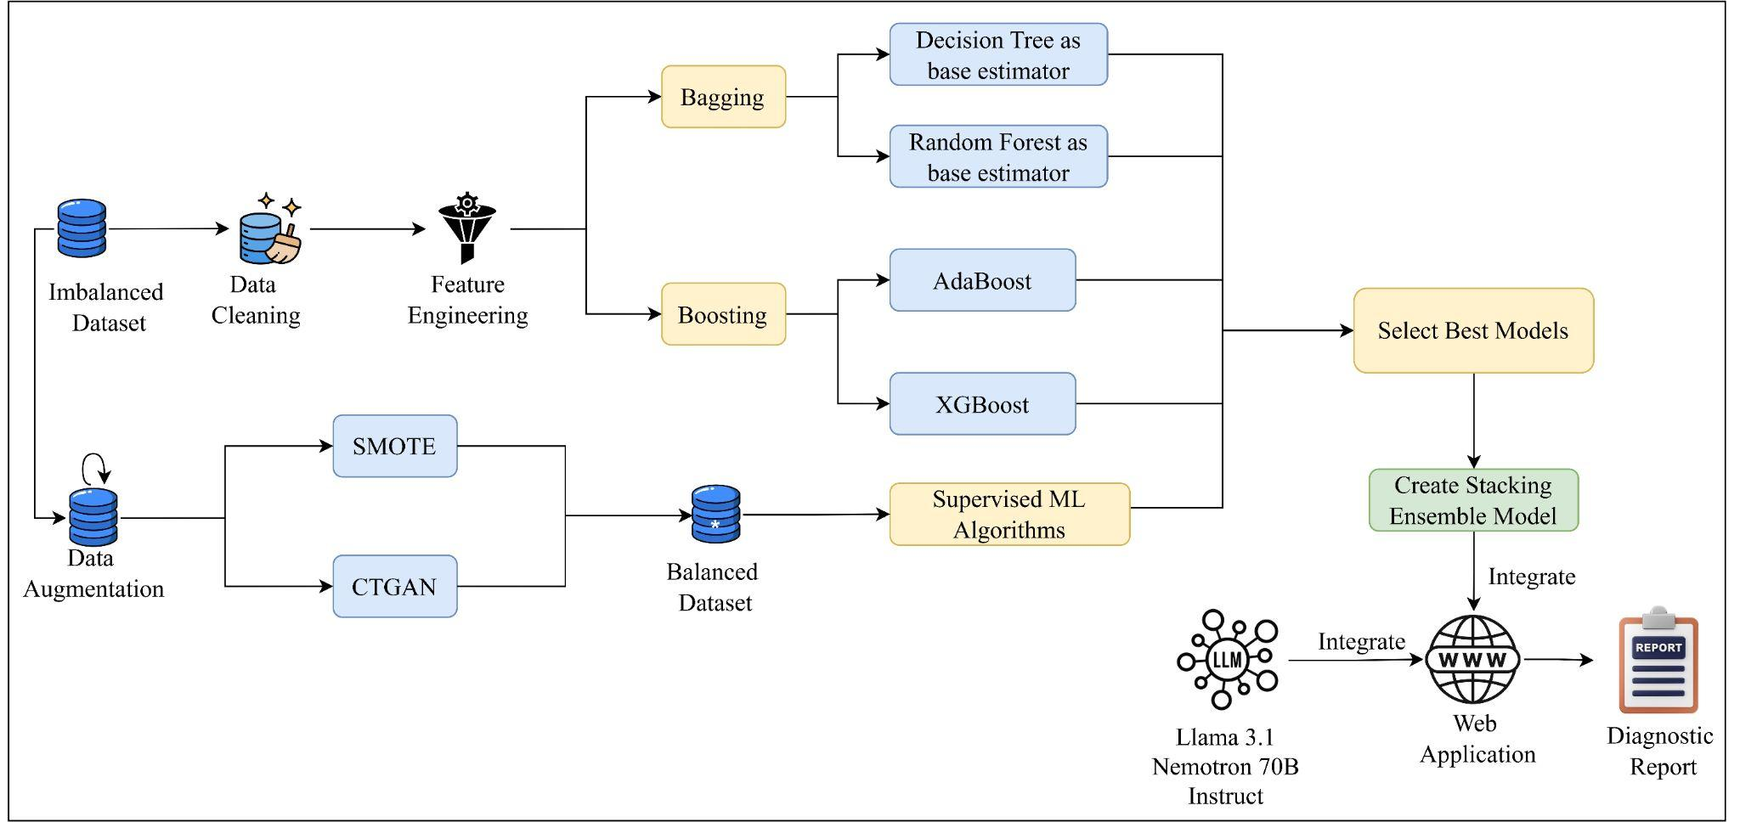
Methodology Block Diagram

Slide 26
Data Preprocessing
Tasks carried out:
Dropping Irrelevant Features
Feature Engineering
Standardization
Label Encoding
Train - Test Splitting
Saving Files

Slide 27
Dropping Irrelevant Features
UID is an identifier which does not add value to the model hence it can be dropped.
Similarly Product ID can be dropped too.
Machine failure is a redundant feature since if any one of the failure mode is 1 (yes), it will be set to 1

Slide 28
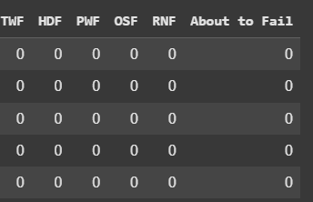
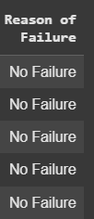
Feature Engineering
Adding New Class:
“About To Fail”
Based on threshold
(275 <= row['Air temperature [K]'] <= 295) or
(275 <= row['Process temperature [K]'] <= 305) or
(900 <= row['Rotational speed [rpm]'] <= 1200) or
(2 <= row['Torque [Nm]'] <= 3) or
(row['Tool wear [min]'] > 250)
2. Instead of having 6 sparse features construct, one dense feature:

Slide 29
Standardization and Label Encoding
Standard Scaling to bring features on same scale
Label Encoding all the categorical features
Train - Test Split: 70% - 30%

Slide 30

Data Visualization

Slide 31
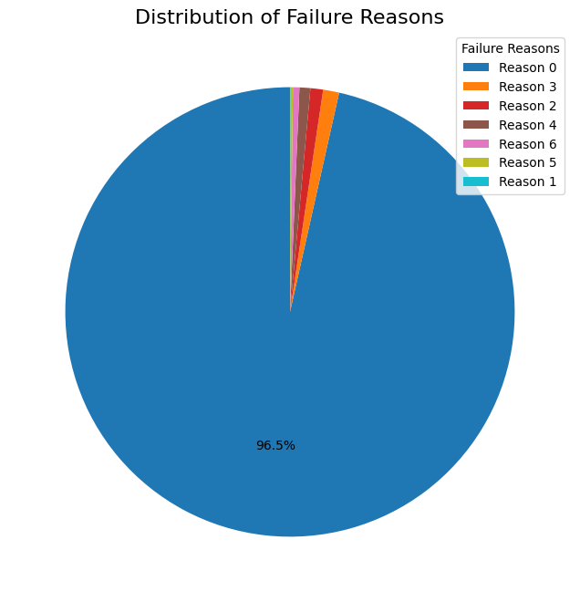
Highly Imbalanced Data

Slide 32
Deciding Metrics for Evaluation
Any dataset of Predictive Maintenance will have a Natural Imbalance because the occurrence of failure is very low rather than success.
Hence Accuracy cannot be a metric for evaluation because it will be biased towards success class.
Instead of Accuracy, we have considered metrics like Precision and Recall.
Precision minimizes false positives (unnecessary maintenance), while recall ensures minimal false negatives (missed failures), optimizing maintenance strategies.

Slide 33

Supervised Machine Learning Algorithms on Imbalanced Data

Slide 34
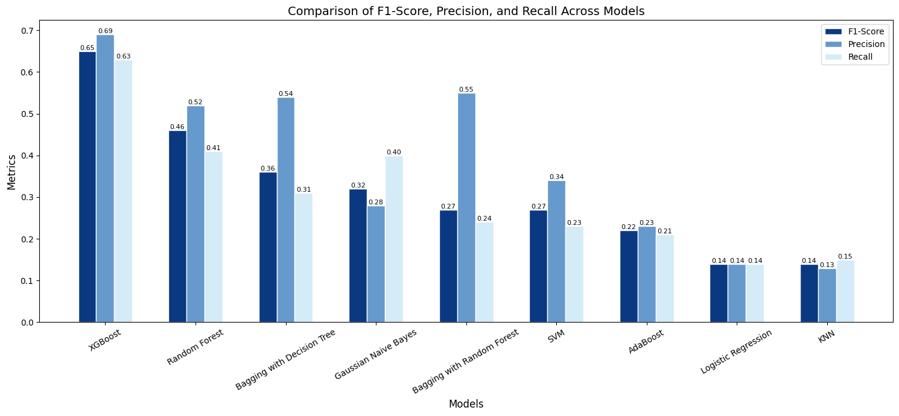
Overview of Results

Slide 35

Data Augmentation using SMOTE

Slide 36
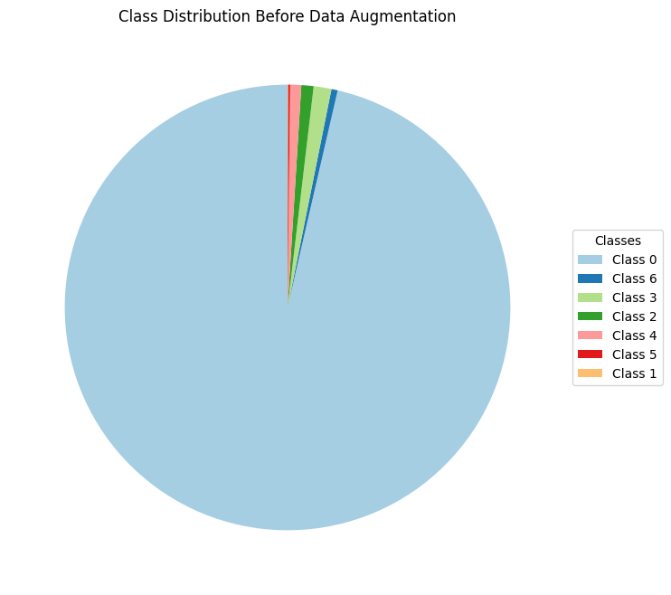
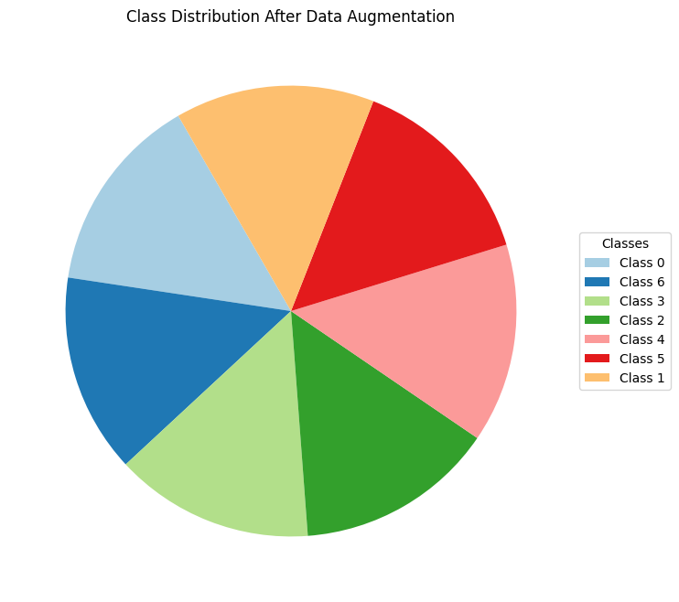
Data Distribution Before and After Augmentation

Slide 37
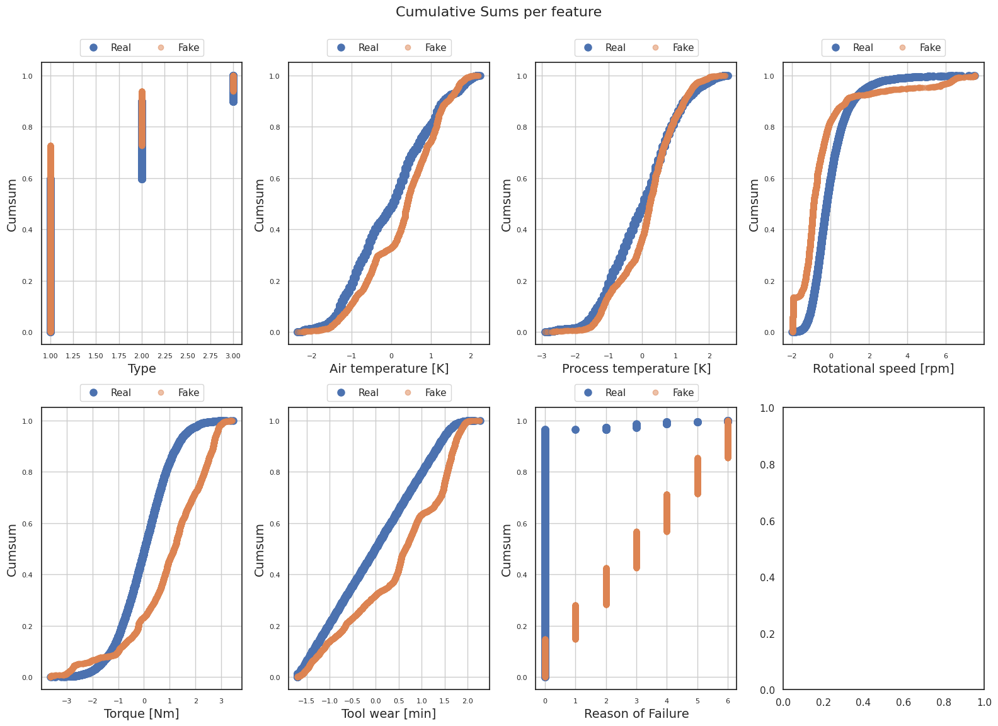
Quality of Data Generated

Slide 38
Data Augmentation using CTGAN

Slide 39
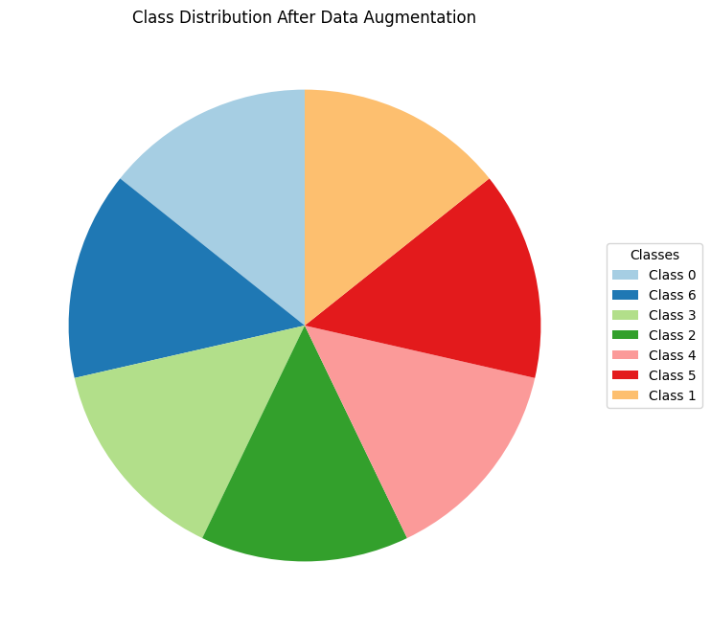
Data Distribution Before and After Augmentation

Slide 40
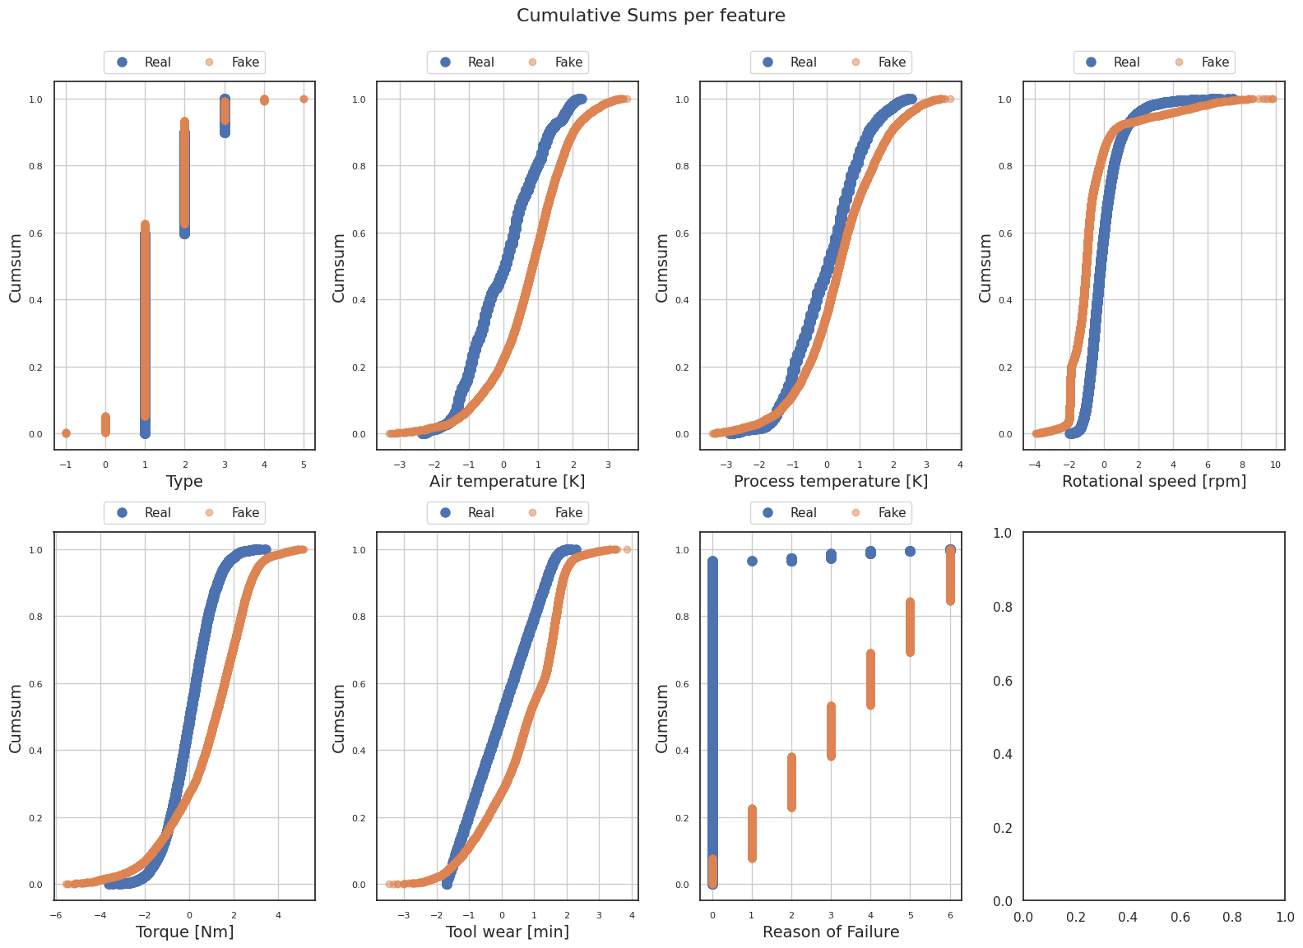
Quality of Data Generated

Slide 41
Deciding Metrics for Evaluation against Augmented Dataset
Now as the dataset is balanced, we can use Accuracy also as a metric
So now the metrics are Precision, Recall and Accuracy

Slide 42
Supervised Machine Learning Algorithms on SMOTE Augmented Dataset

Slide 43
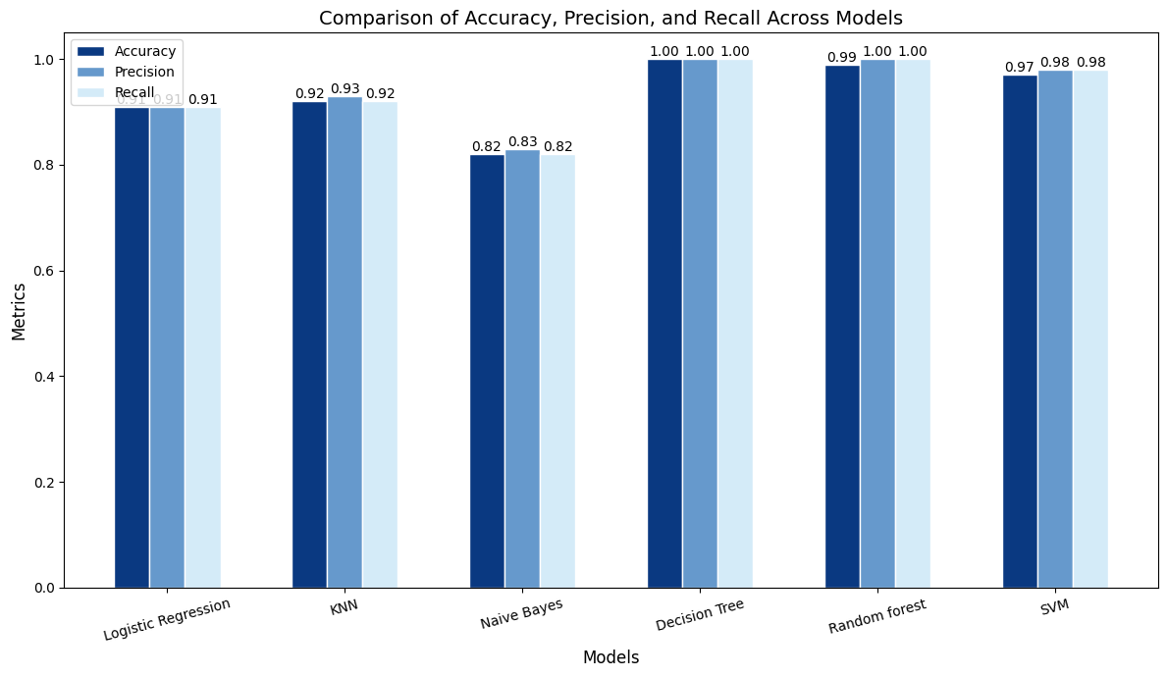
Comparative Analysis

Slide 44
Supervised Machine Learning Algorithms on CTGAN Augmented Dataset

Slide 45
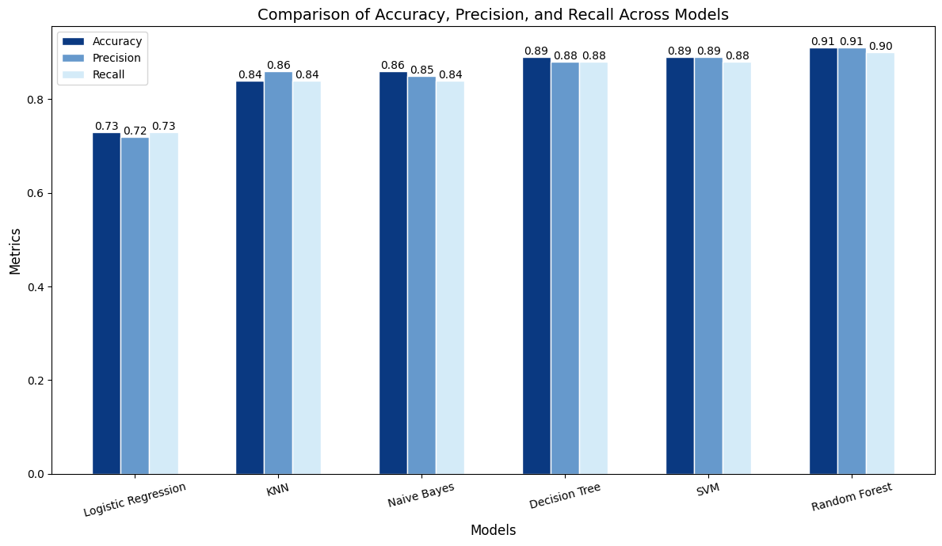
Comparative Analysis

Slide 46
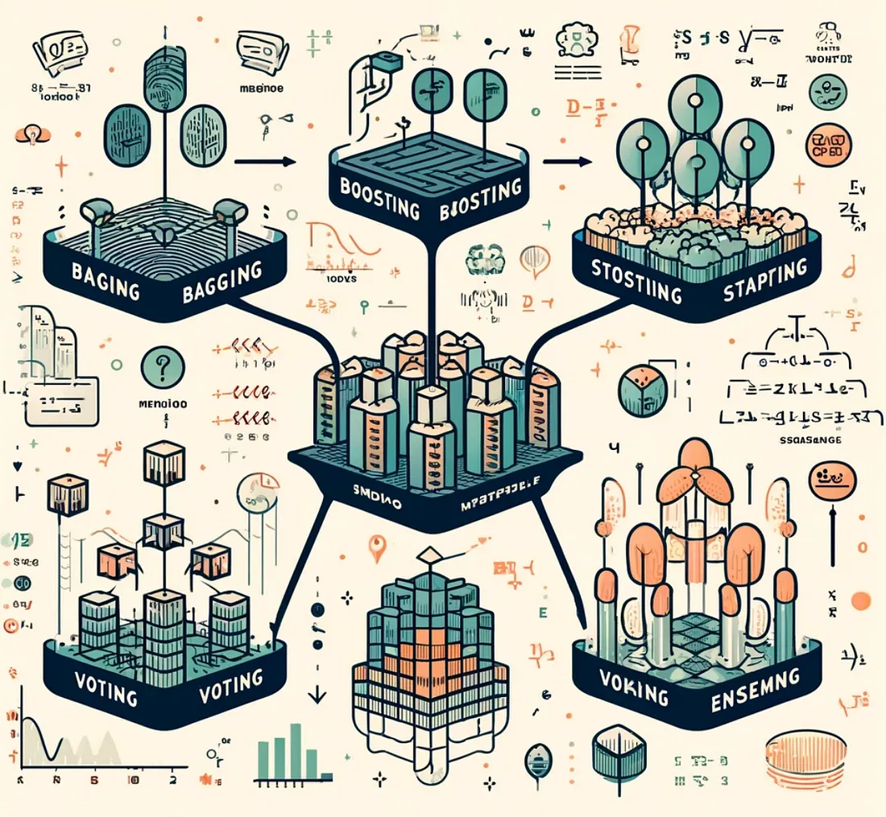
Stacking Ensemble Model

Slide 47
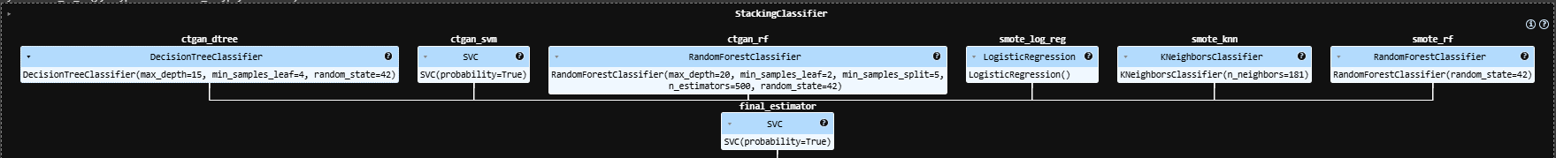
Stacking Ensemble Model

Slide 48
Training and Testing
SMOTE augmented dataset and CTGAN augmented dataset were aggregated to make a balanced training data.
The test dataset was also aggregated in the same way

Slide 49
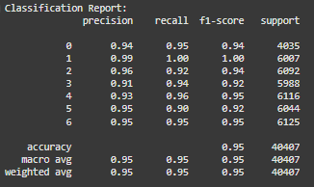
Results of Stacking Model

Slide 50
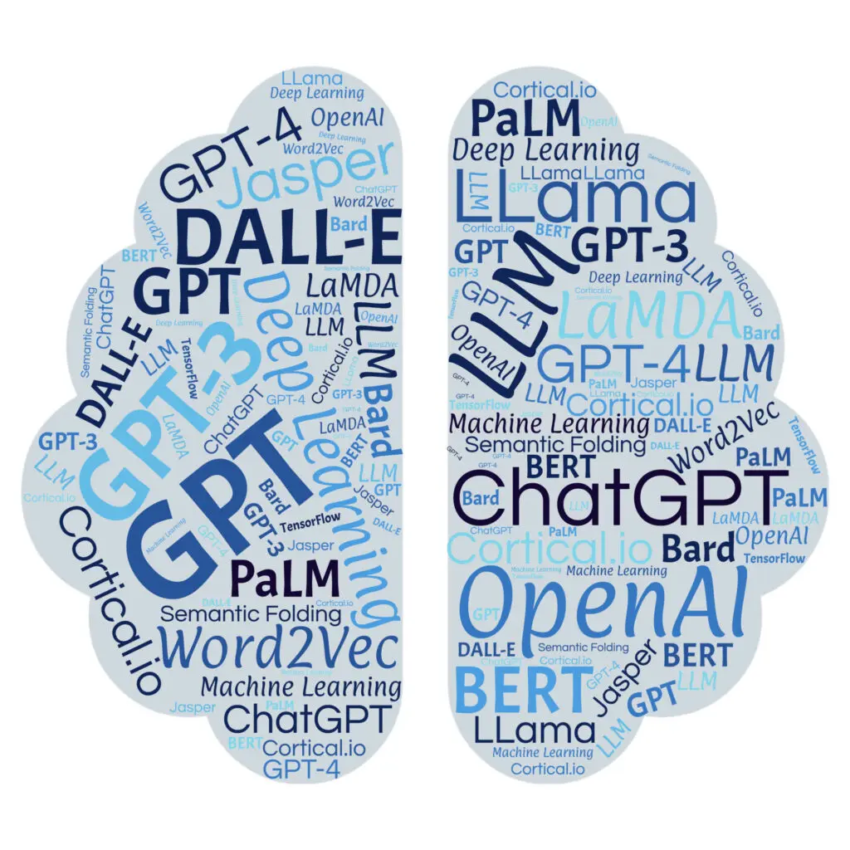
About
LLM

Slide 51
Selection of Large Language Model
LLM: Llama-3.1-Nemotron-70B-Instruct by Nvidia
Nvidia improved the Meta's Llama 3.1 to generate helpful and human like responses, which best fits our use case.
Arena-Hard Score:
Llama-3.1 - 51.6
Llama-3.1-Nemotron-70B-Instruct - 70.9
Model Architecture:
Architecture Type: Transformer
Network Architecture: Llama 3.1

Slide 52
What is Arena-Hard Score:
It is an automatic evaluation tool for instruction-tuned LLMs.
Key features of the Arena-Hard benchmark include:
Reflects human preference in real-world use cases: The benchmark score has a high agreement with human preference.
Frequently updates to avoid over-fitting or test set leakage: It uses new, unseen prompts to ensure the benchmark remains challenging and relevant.

Slide 53
Why Llama-3.1-Nemotron-70B-Instruct
Reflects human preference in real-world use cases: The benchmark score has a high agreement with human preference.
Best acc to following comparisons

Slide 54
Overview of the Llama-3.1-Nemotron accuracy and efficiency.
Name of LLM | MT Bench* | MMLU*
Llama 3.1-Nemotron-70B-Instruct | 8.93 | 81.66 %
Llama-3.1- Nemotron-51B-Instruct | 8.99 | 80.2 %
Llama 3-70B | 8.94 | 80.17 %
*MT - Bench - Designed to test Multi-Turn conversation and instruction-following ability, covering common use cases and focusing on challenging questions to differentiate models.
*MMLU - Massive Multitask Language Understanding: Aims to enhance how machines interpret and process human language significantly.
Source: Nvidia Blog

Slide 55
Prompt Used
Generate a diagnostic report based on the following machine parameters:
Air Temperature [K]: {Air_temp}
Process Temperature [K]: {Process_temp}
Rotational Speed [rpm]: {Rot_speed}
Torque [Nm]: {Torque}
Tool Wear [min]: {Tool_wear}
and the predicted failure class: {predicted_class} (one of the following: TWF - Tool Wear Failure, HDF - Heat Dissipation Failure, OSF - Overstrain Failure, PWF - Power Failure, RNF - Random Failure, About to Fail, or No Failure).
Include in the report:
A brief summary of the operational parameters.
Actionable recommendations tailored only to the specific failure class {predicted_class} provided. Avoid listing or referring to other failure classes.
If the failure class is "No Failure," confirm that the machine is operating normally and requires no immediate maintenance, while suggesting continued monitoring and scheduled maintenance.
Ensure the output is concise, actionable, and relevant to the provided parameters.

Slide 56

Web
Application

Slide 57
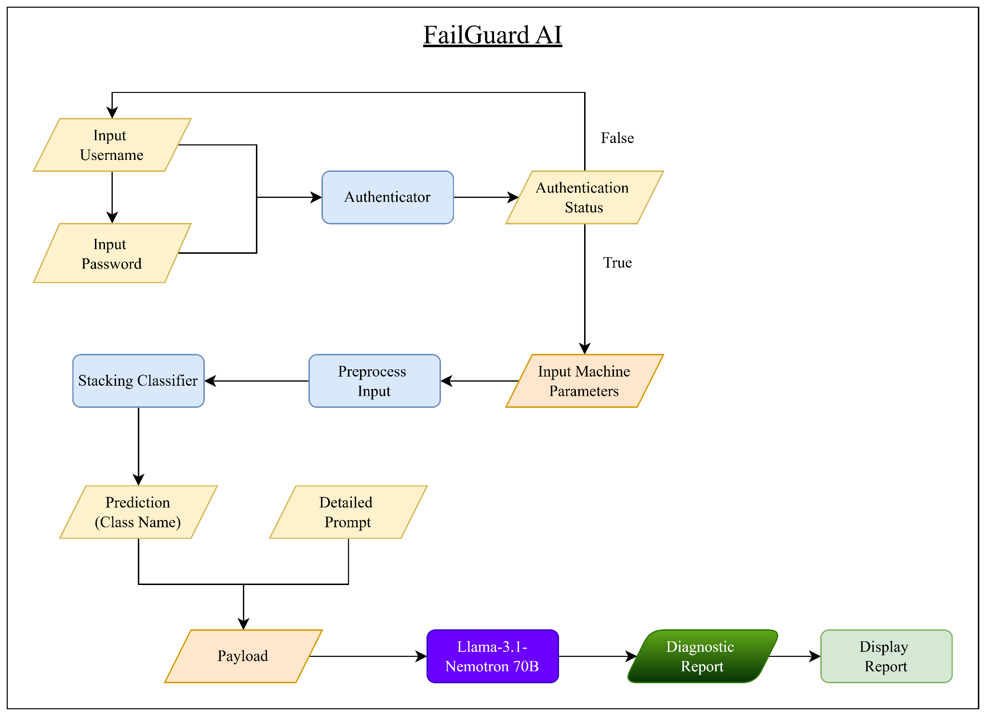
Web Flow Diagram

Slide 58
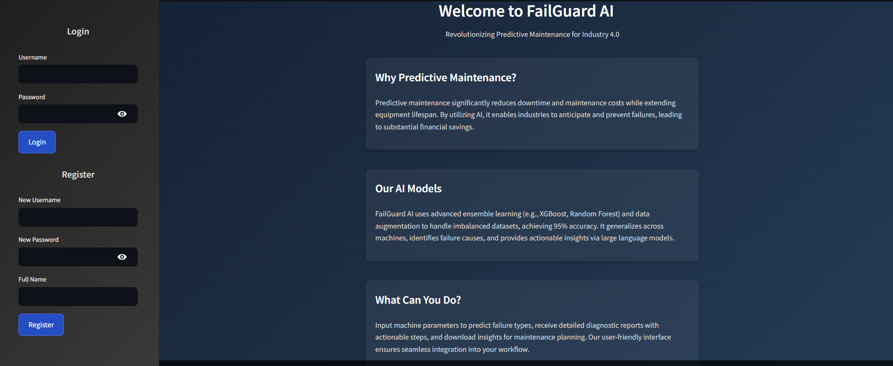
FailGuard AI

Slide 59
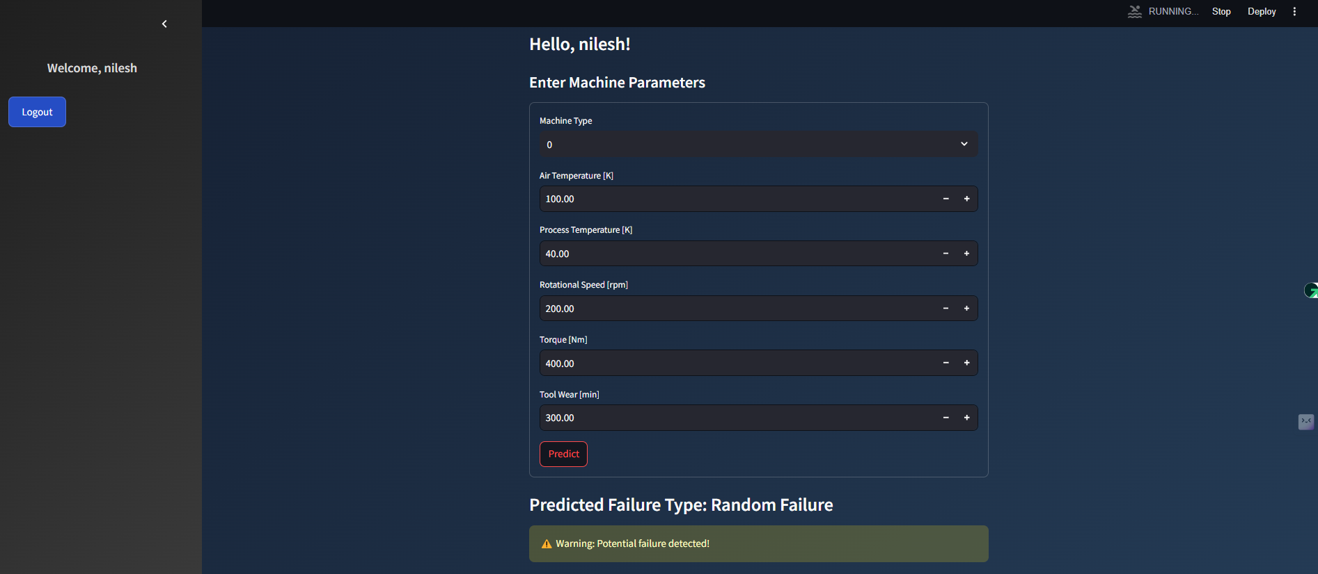
FailGuard AI

Slide 60
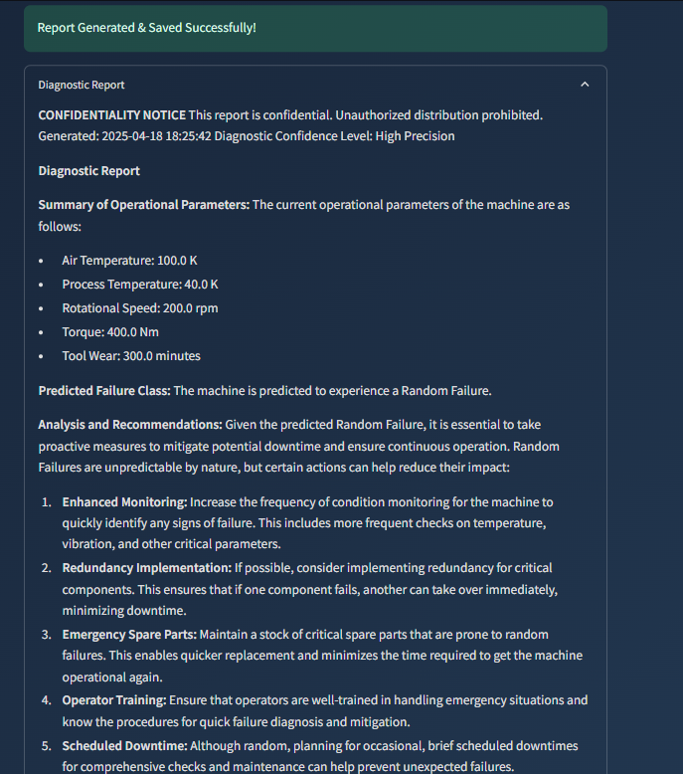
FailGuard AI

Slide 61
Advantages
The system is able to fulfill all the objectives i.e. Failure Prediction, Type of Failure and Diagnostic Report
Besides objectives, the system also delivers the identified literature gaps
Building a robust generalized System
Identifying the reason why machine failed
Giving instructions to operators through report

Slide 62
Disadvantages
The diagnostic report generated by the LLM depends heavily on its prompt and fine-tuning. It may produce inaccurate or irrelevant information if the input is misinterpreted or incomplete.
The system requires a constant internet connection.

Slide 63
Future Scope
Fine Tune LLM for the specific use case.
Implement a RAG (Retrieval Augmented Generation) architecture for more relevant results.
Enhance explainability of results with the help of XAI architectures like SHAP (SHapley Additive exPlanations) or LIME (Local Interpretable Model-agnostic Explanation)
Validate the responses with the help of SMEs
Experiment on various LLMs using various fine-tuned prompts for better results.

Slide 64
Conclusion
Handled the Data challenges using Statistical and GenAI techniques.
The project offers comprehensive solution to the problem of predictive maintenance.
The project aligns closely with real-world industrial scenarios providing actionable insights to machine operators.
The modular design of the system allows for scalability and adaptation to other predictive maintenance datasets, though further testing is needed to generalize the solution.

Slide 65
Thank You!

